Slide 1
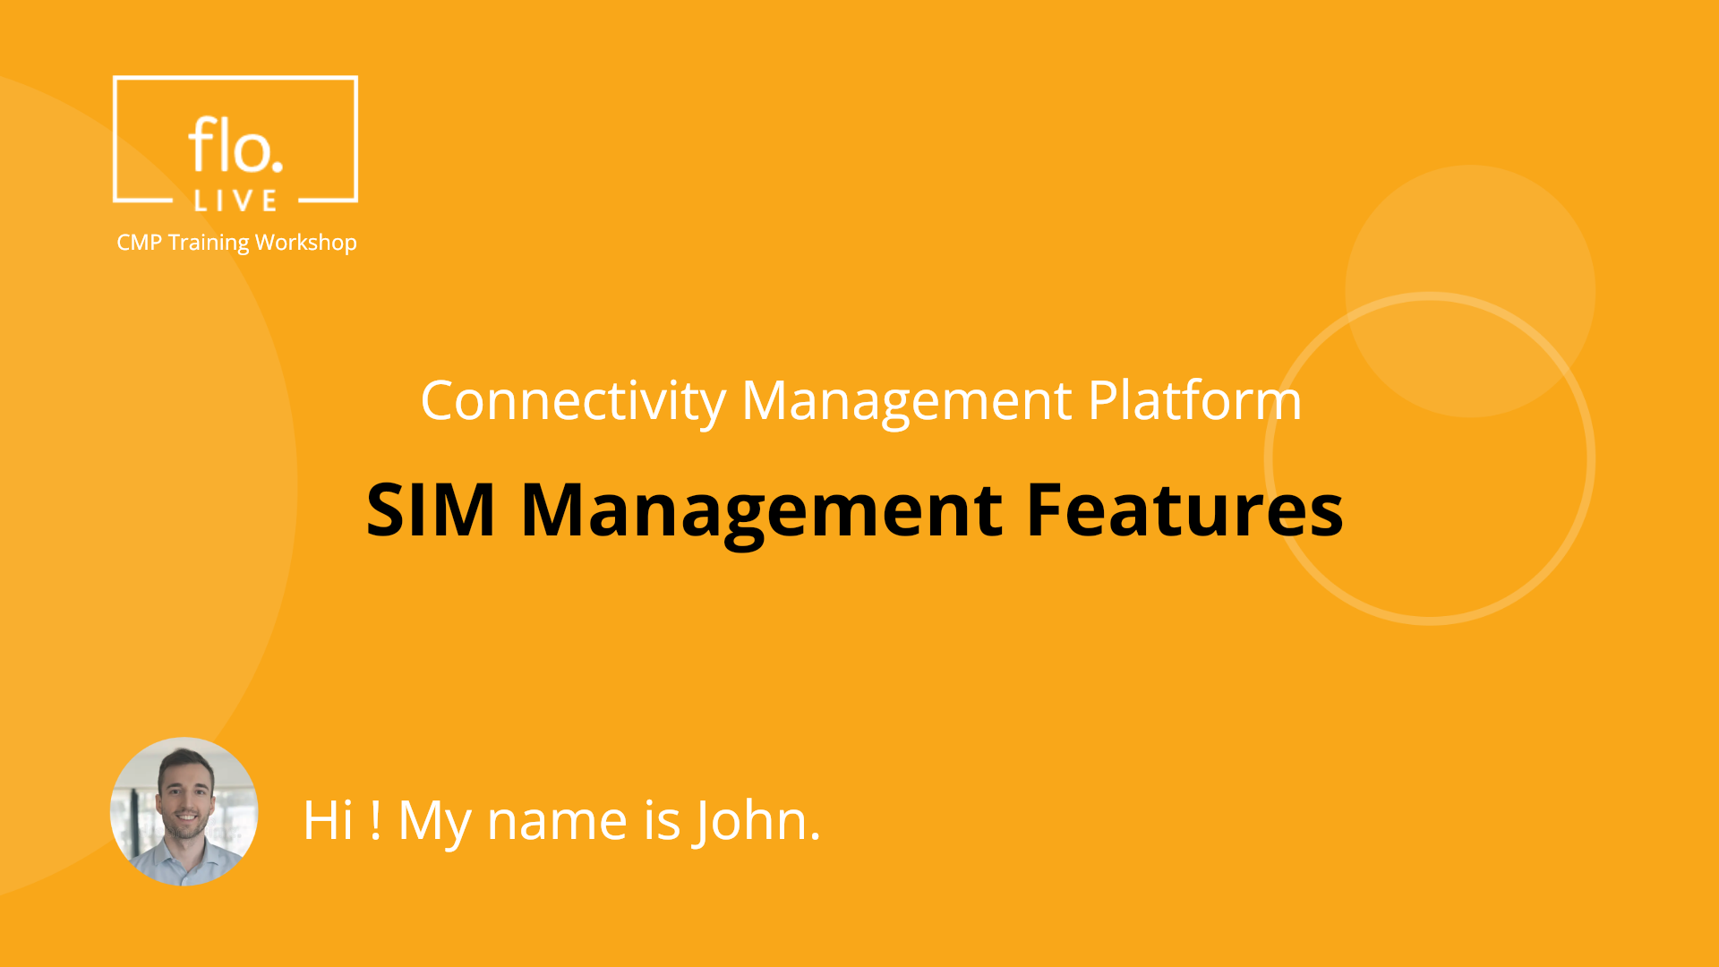
Notes:
Hi, My name is John and welcome to the CMP SIM Management Training Workshop.

Slide 2
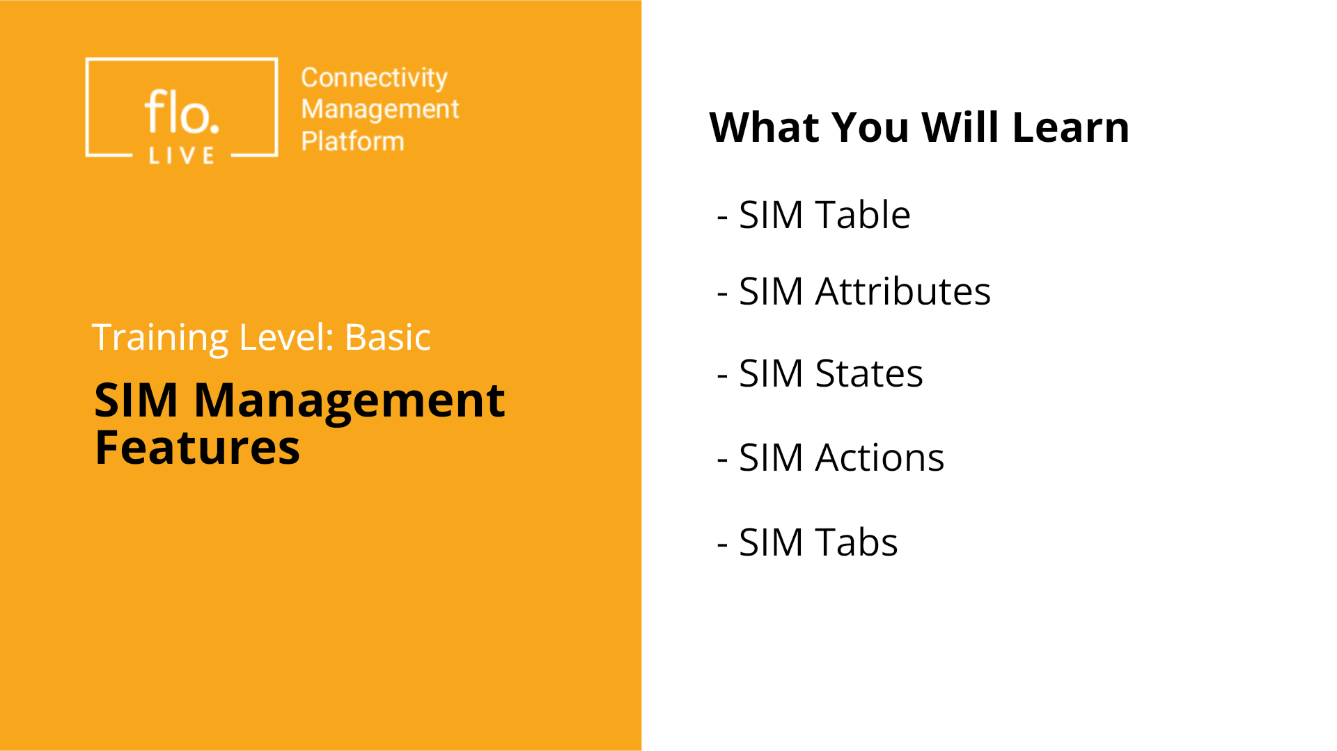
Notes:
In this tutorial we explore the main features of the CMP SIM Management module. This is the central place for managing SIM inventory in the Connectivity Management Platform. You will learn about the SIM Table and SIM attributes; . You will also learn about the various SIM state and available actions; including filtering and export capabilities. Finally, you will learn how to find detailed information in the various SIM tabs. Let's begin.

Slide 3
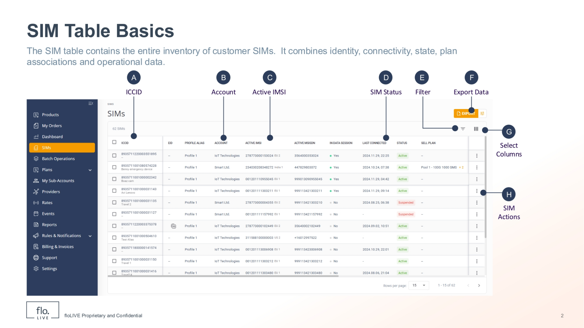
Notes:
The SIM table serves as a central inventory for managing customer SIMs and it displays different types of data. |An importan type of data are the Core Identifiers such as the ICCID, the Account owner, and the Active IMSI. There are many different core identifiers which you can show or hide by customizing the SIM table columns. Another type of information includes the SIM Status which may be active, inactive, suspended or teminated. The SIM table also includes various tools such as the Select Column and Filter panels. There is also an Export function that enables you to share data via a CSV file.

Slide 4
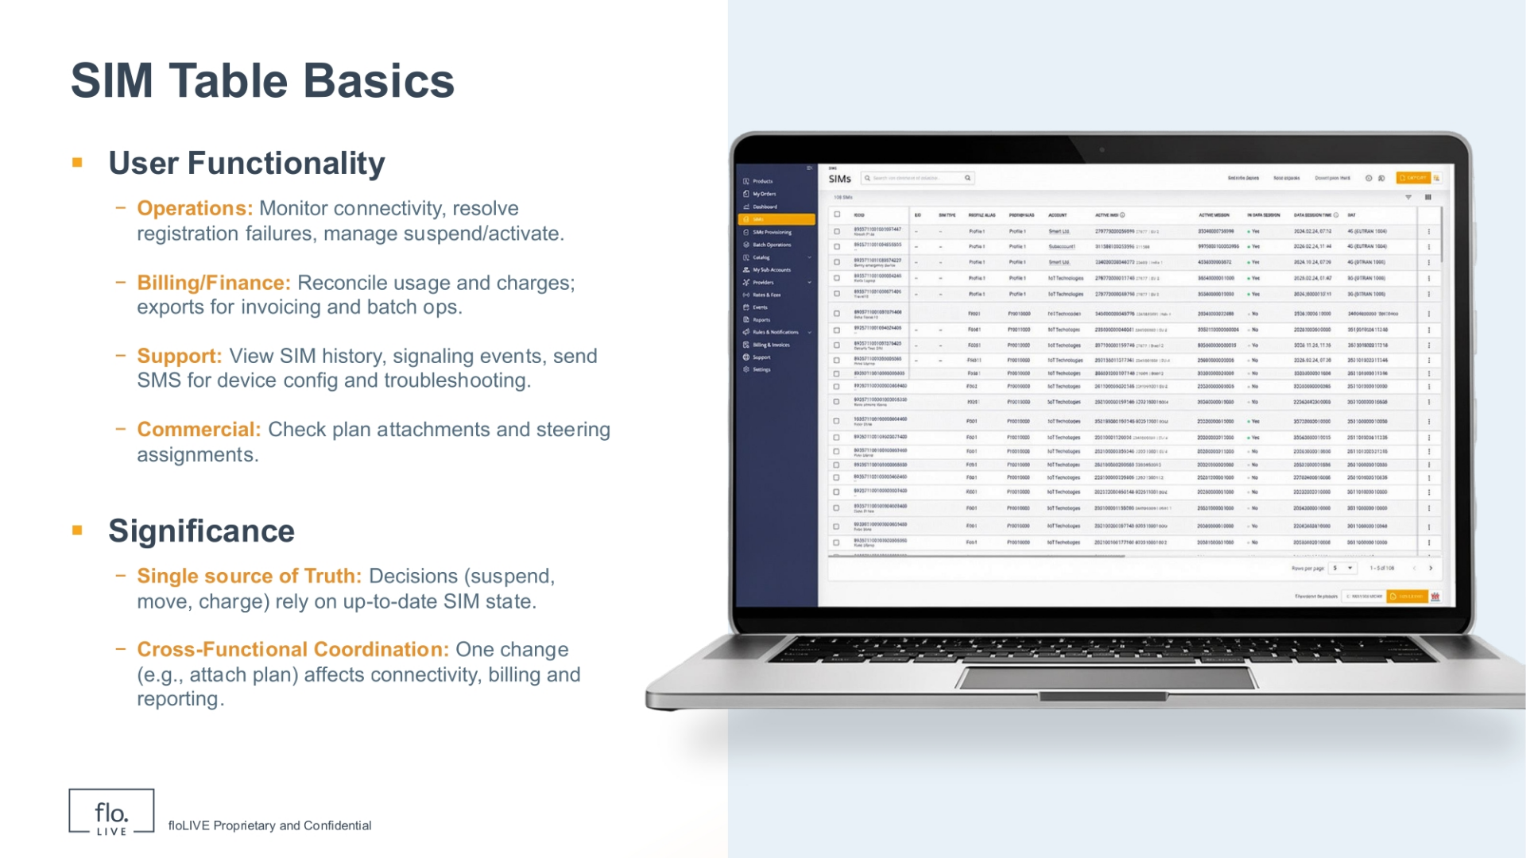
Notes:
The CPM SIM table serves different purposes for different types of users. Operational users generally monitor connectivity and manage SIM activation. The billing team reconciles usage and generate exports. The Support Team usually reviews the SIM history and identifies messages for troubleshooting purposes. Users involved in the commercial aspects rely on the SIM table to verify plan attachments and steering assignments. In summary, it is important to understand that the SIM table serves as a "single source of truth", where every change directly impacts connectivity, billing, and reporting.

Slide 5
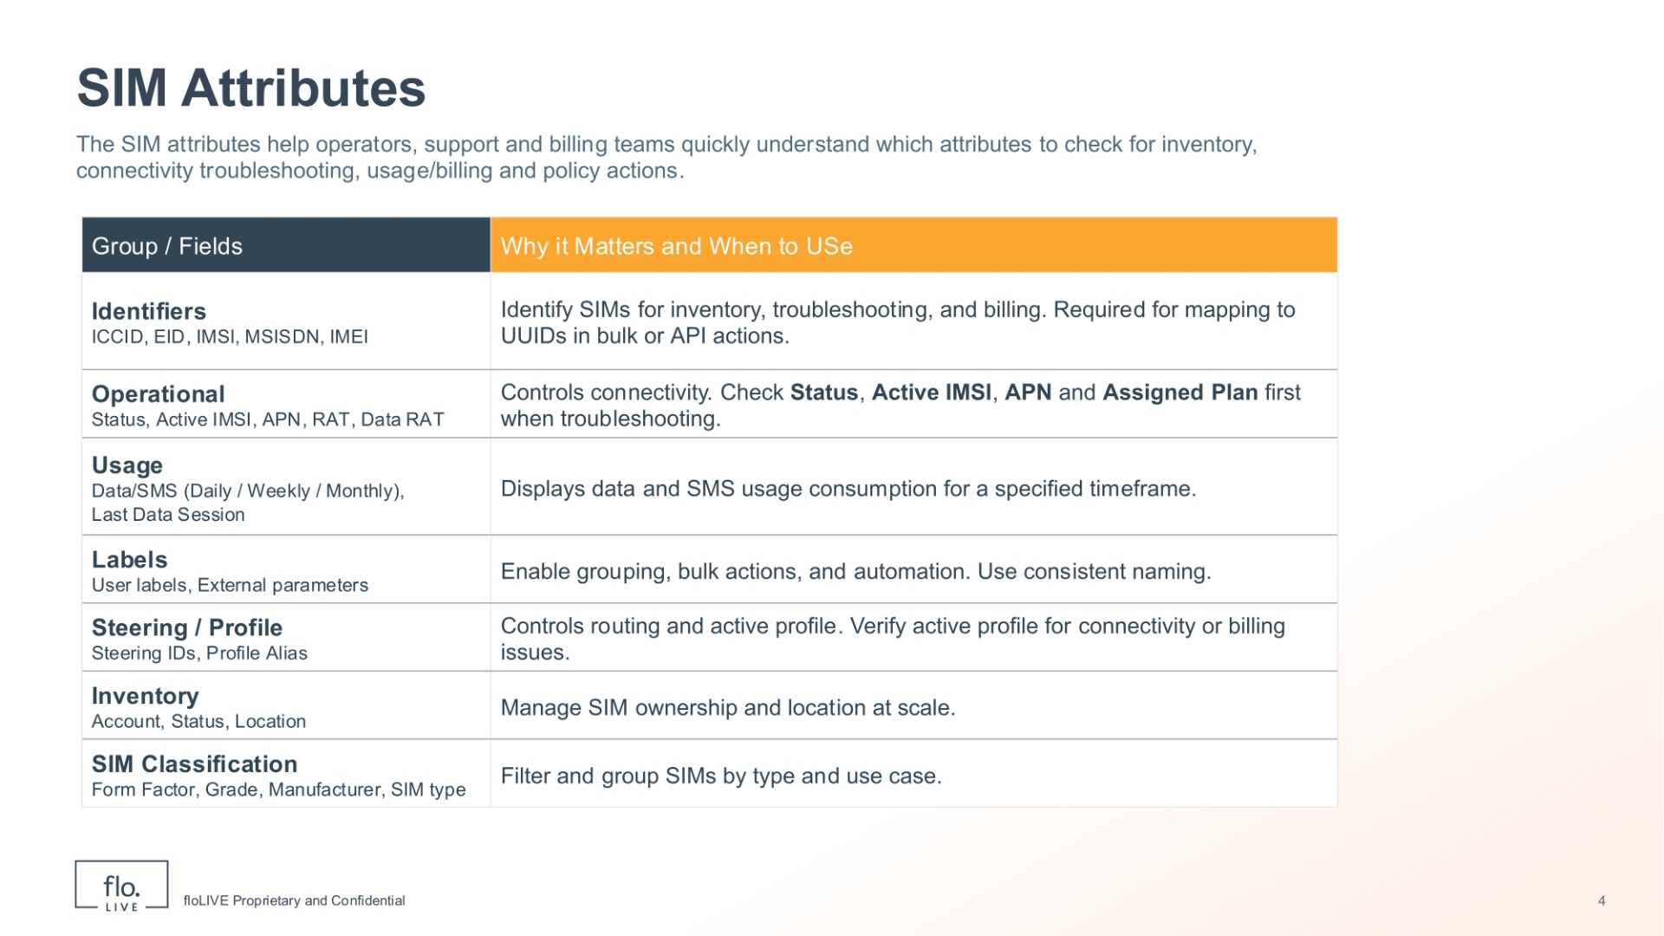
Notes:
Lets review the SIM Attributes Feature in the CMP. SIM attributes help you to check inventory; connectivity; usage; billing and policy actions. The Identifier attributes help you to uniquely identify SIMs and are used for inventory, billing, and bulk or API actions. The Operational attributes control connectivity. When troubleshooting, always check the SIM status; the active IMSI; the APN configuration and the attached plan as the first point of your investigation. Usage attributes focus on data and SMS usage for a specified timeframe. Labels are useful for grouping of SIMs, bulk actions, and automation. The Steering and profile attributes control routing and the active network profile. Finally, the Inventory and SIM classification attributes help manage and filter SIMs at scale.

Slide 6
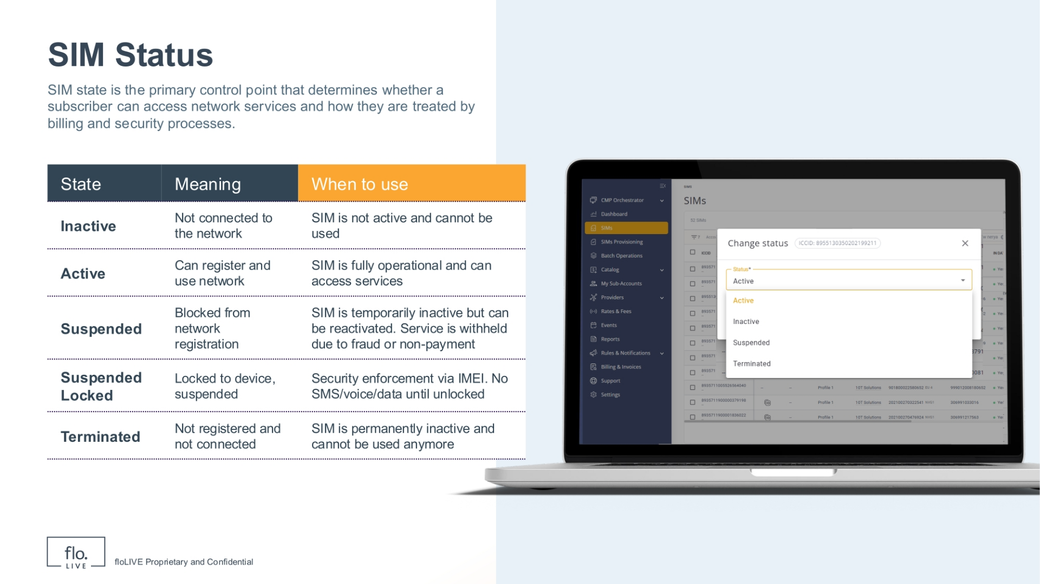
Notes:
Lets move forward and explore the various SIM States. The SIM state controls whether a SIM can access the network and how it is handled by billing and security. Inactive SIMs are disabled and cannot be used. Active SIMs are fully operational and can register and use network services. Suspended SIMs are temporarily blocked from the network, usually due to billing or security reasons, but can be reactivated and reused. Suspended Locked SIMs add an extra security layer by locking the SIM to a specific device using the IMEI. Terminated SIMs are permanently disabled and cannot be used again. In summary, changing the SIM state allows operators to control service access and respond to operational or commercial needs

Slide 7
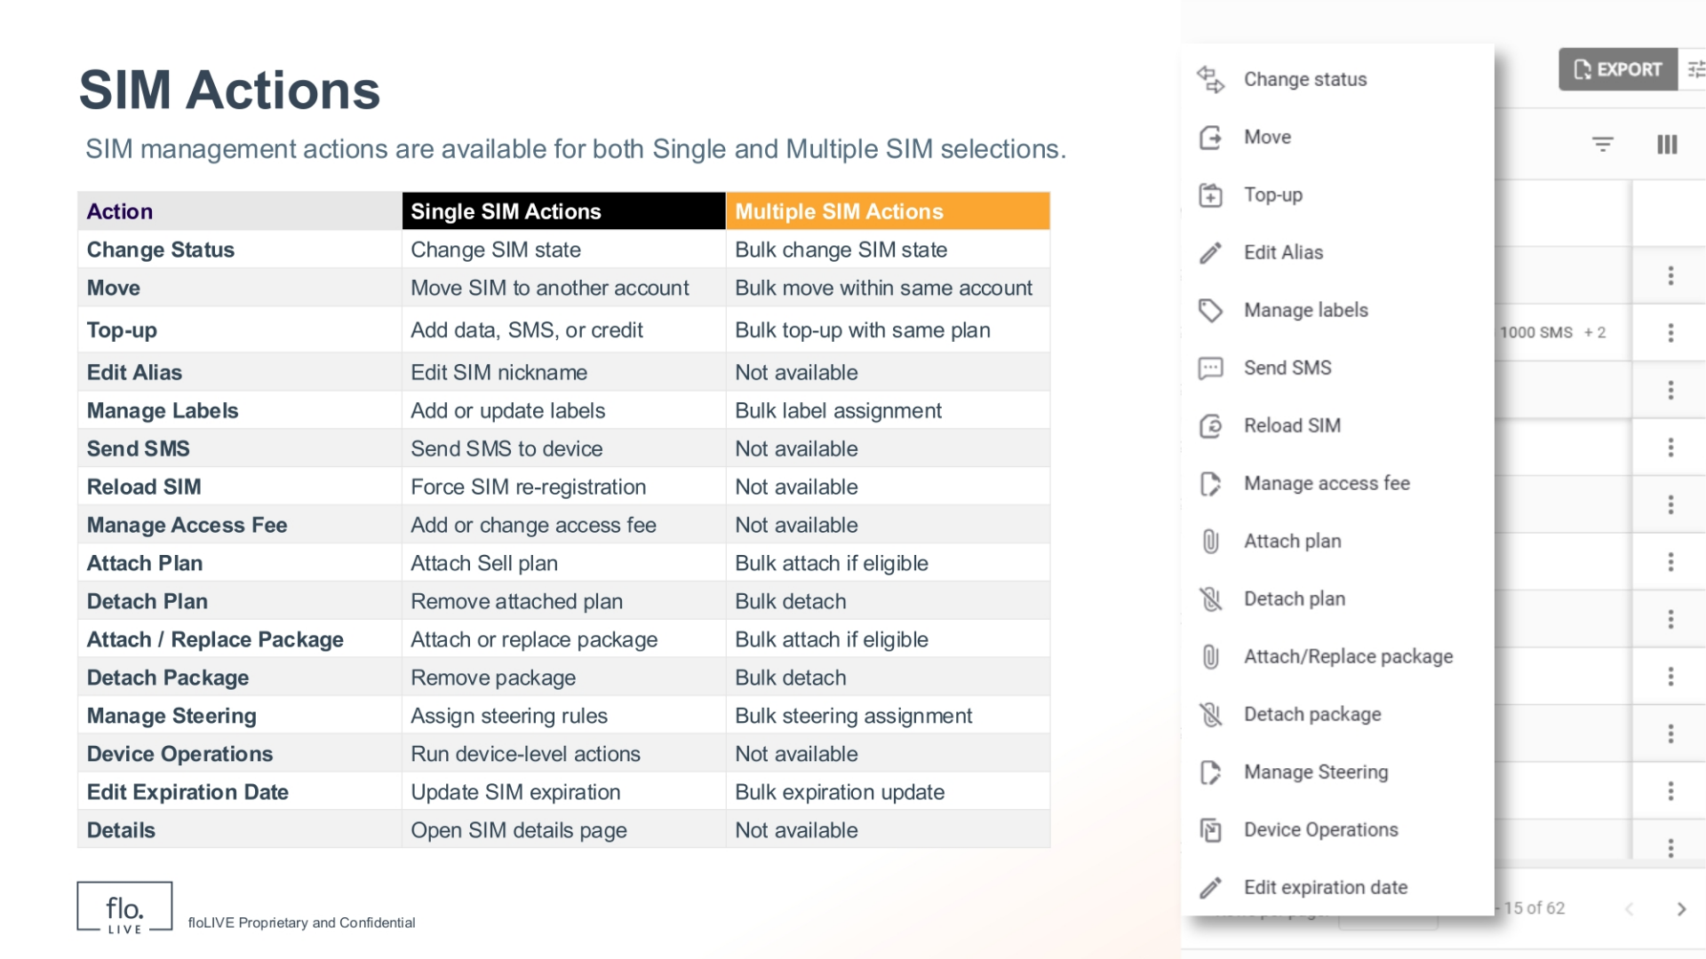
Notes:
The SIM Actions feature enables you to make operational, commercial, and configuration changes to SIMs displayed in the table. This table shows the actions available when working with SIMs. Notice the key distinction here is whether an action applies to a single SIM or can be used in bulk. Some actions are clearly single‑SIM focused, such as editing the alias, sending an SMS, reloading the SIM, or opening the SIM details page. These actions are typically used for troubleshooting or making targeted changes. Other actions are designed for managing SIMs at scale. For example, changing status; moving SIMs between accounts; applying labels; or attaching plans in bulk. Commercial actions control how the SIM is billed and when it is valid. These actions include top‑ups for plans and packages, assigning access fees, and updating the expiration dates. Configuration actions, such as steering and device operations, affect how the SIM behaves on the network. Together, these actions let you manage individual SIMs when precision is needed, or large SIM groups when efficiency matters.

Slide 8
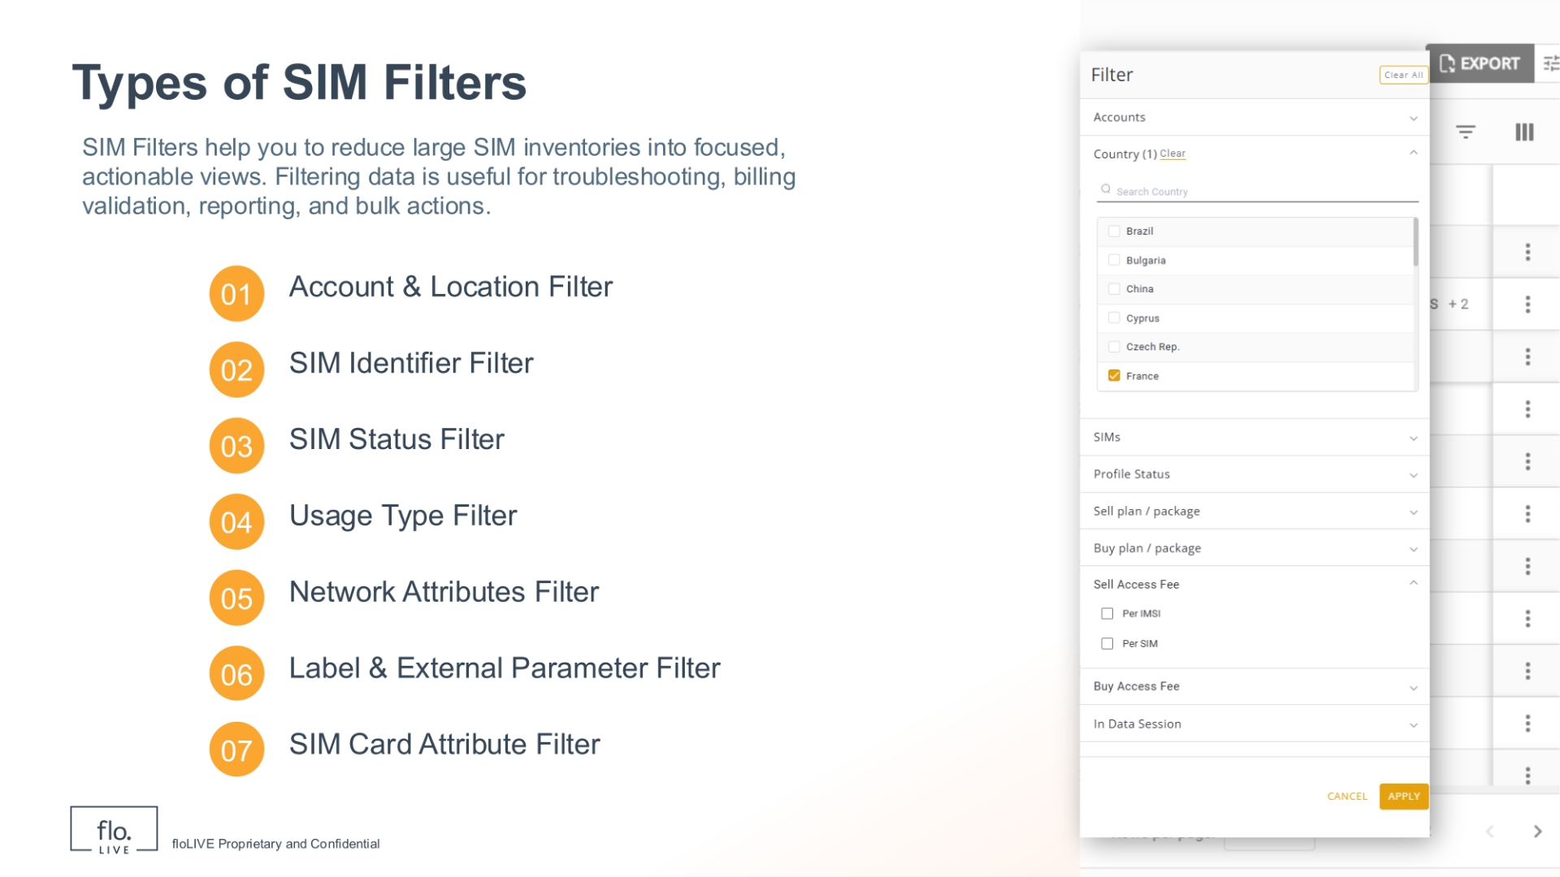
Notes:
SIM Filters are useful because they help you to reduce large SIM inventories into focused, actionable views. Filtering data is frequently used for troubleshooting, billing validation, reporting, and bulk actions. There are 7 different types of filters and each category contains various SIM attributes. Lets take a look at some of these Filters and their attributes.

Slide 9
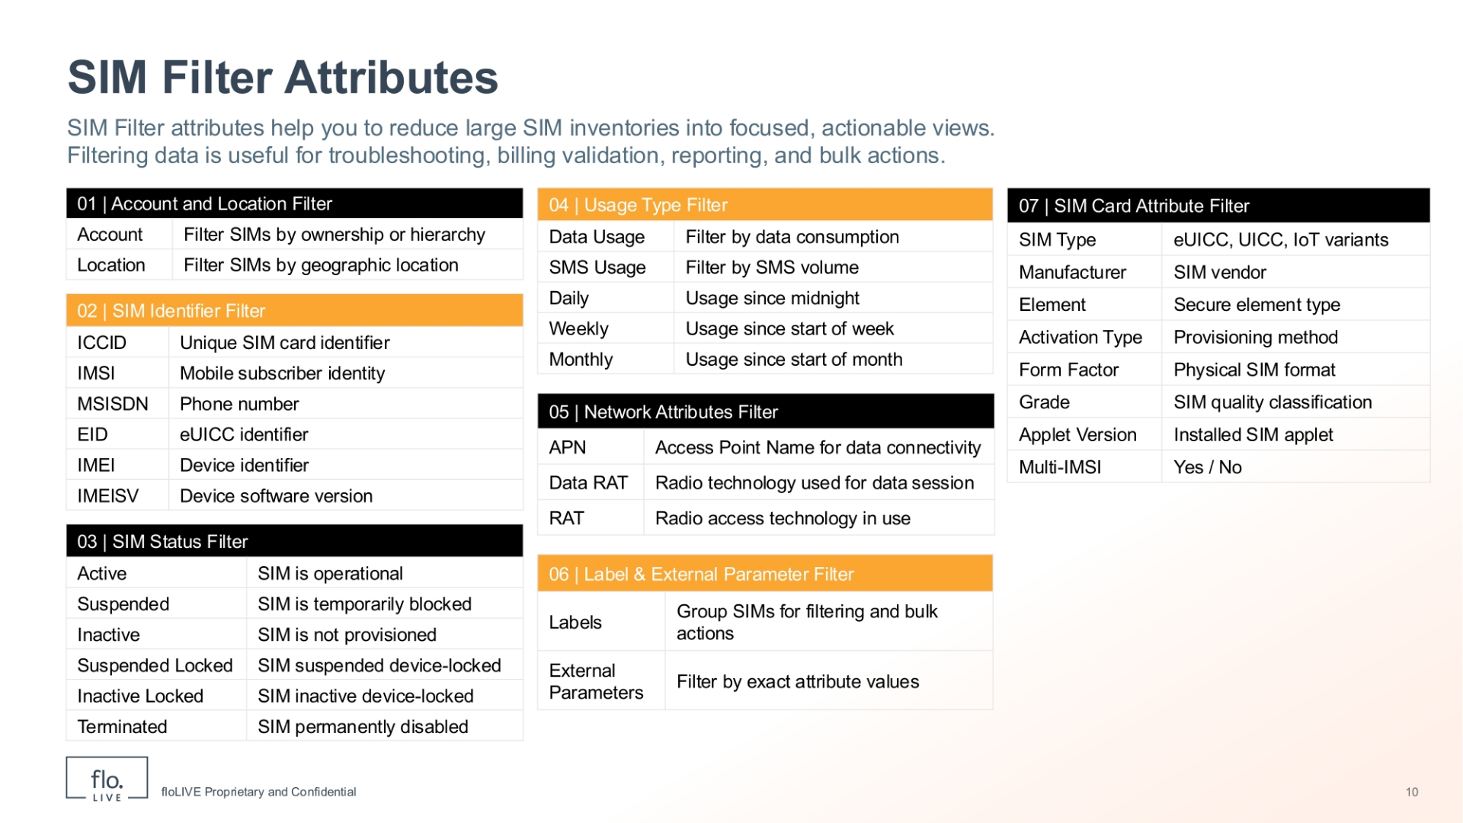
Notes:
The SIM Filter enables you to narrow down the SIMs table and focus only on the SIMs that are relevant to your task. Table 1 shows how you can filter SIMs by organizational context, such as account and location, making it easy to work within specific customers or regions. Table 2 contains the Identifier‑based filter attributes which enable you to locate SIMs using values like ICCID, IMSI, MSISDN, or IMEI, across all eUICC profiles. Table 3 shows the status‑based filtering attributes including: active, suspended, inactive, locked, or terminated SIMs, depending on your operational or billing needs. For billing and monitoring purposes, you can use the usage filters shown in Table 4. These filters enable you to evaluate data or SMS consumption over daily, weekly, or monthly time periods. Table 5 shows how you can filter the SIM table for Network attributes including APN connectivity, Data RAT and RAT technologies. You can further refine resultsby using the label and external parameter filters described in Table 6. Finally, you can filter the SIM Card attributes in Table 7 to reveal information such as SIM type, manufacturer, form factor, activation type, or multi‑IMSI support. In summary, the Filter Panel provides a flexible and powerful way to reduce large SIM inventories into precise, actionable views that enable you to perform specific tasks.

Slide 10
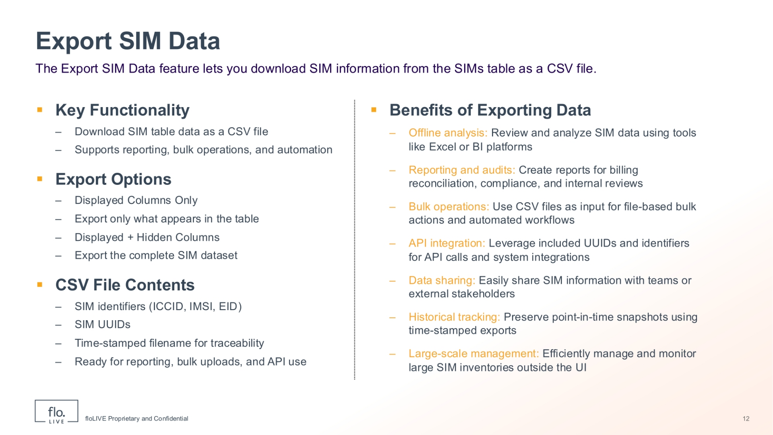
Notes:
The Export SIM Data feature enables you to download SIM information from the SIMs table as a CSV file. You can choose to export only the columns currently displayed, or include both displayed and hidden columns for a complete dataset. The exported file includes key SIM identifiers and UUIDs. Each exported data file is time‑stamped for traceability, and is ready for reporting, bulk operations, and API use. Exporting SIM data is useful for offline analysis, archiving, audits, system integrations, and efficient management of large SIM inventories.

Slide 11
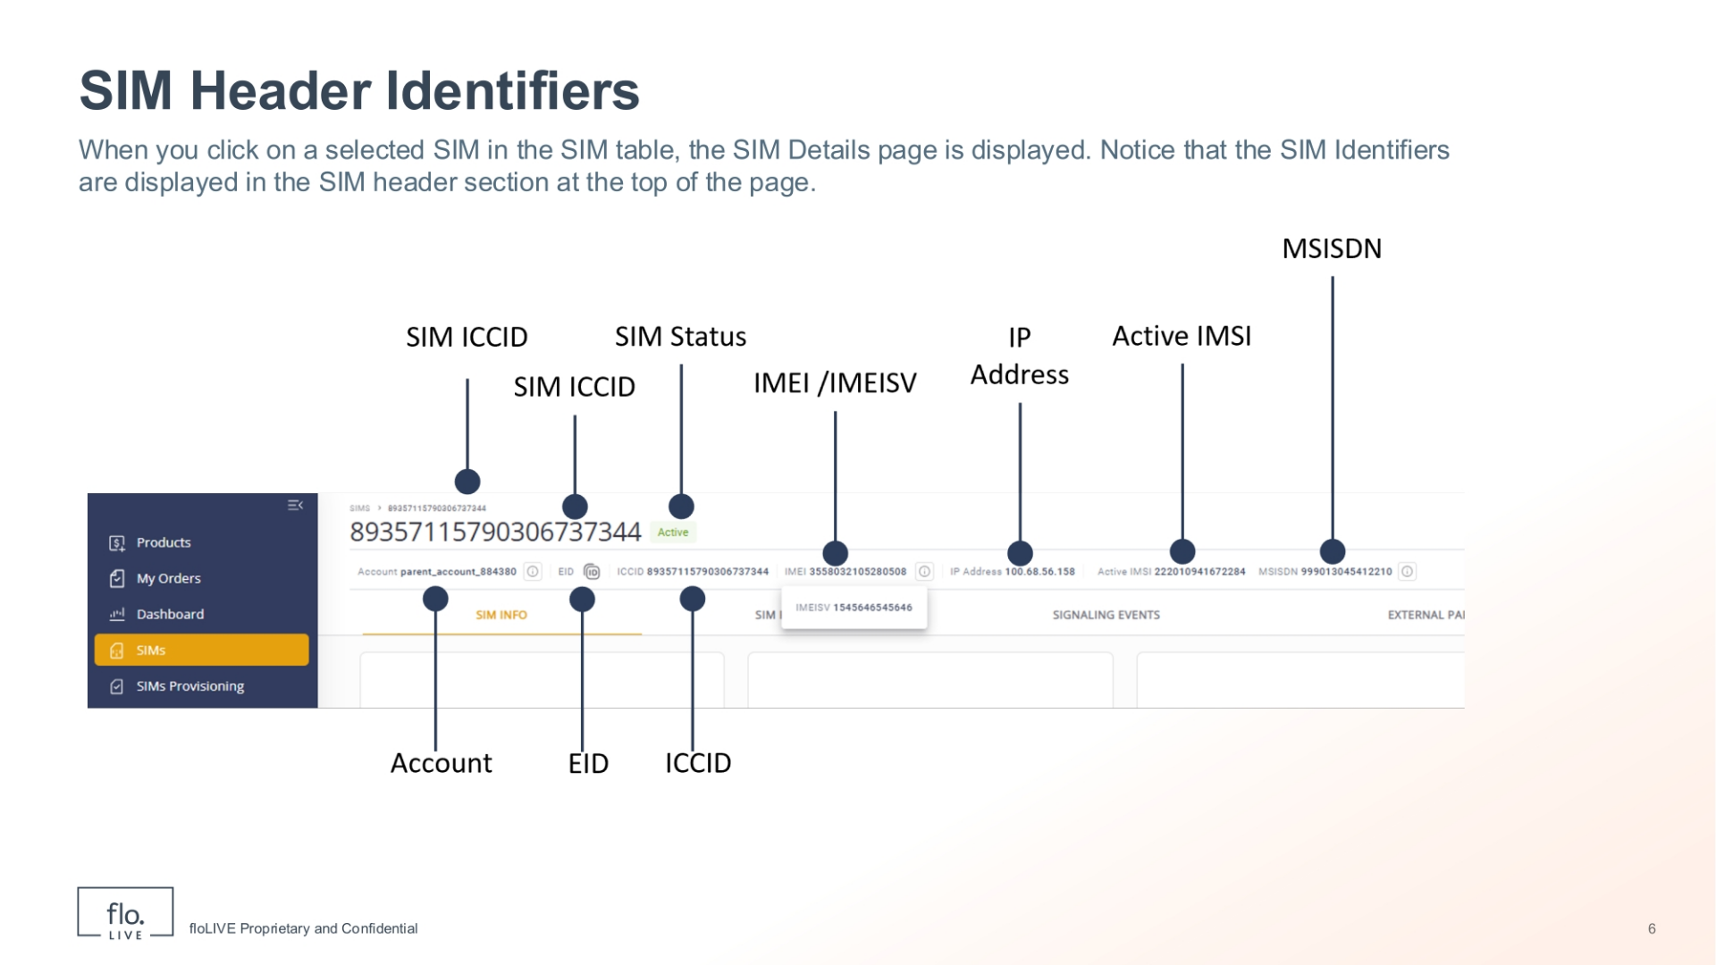
Notes:
When you click on a selected SIM in the SIM table, the SIM Details page is displayed. Notice that the SIM Identifiers are conveniently displayed in the SIM header section at the top of the page. Here you can view identifiers such as the SIM alias, ICCID, current status, active IMSI, and MSISDN, along with account and device information. These identifiers confirm you are working on the correct SIM and are useful for troubleshooting and billing.

Slide 12
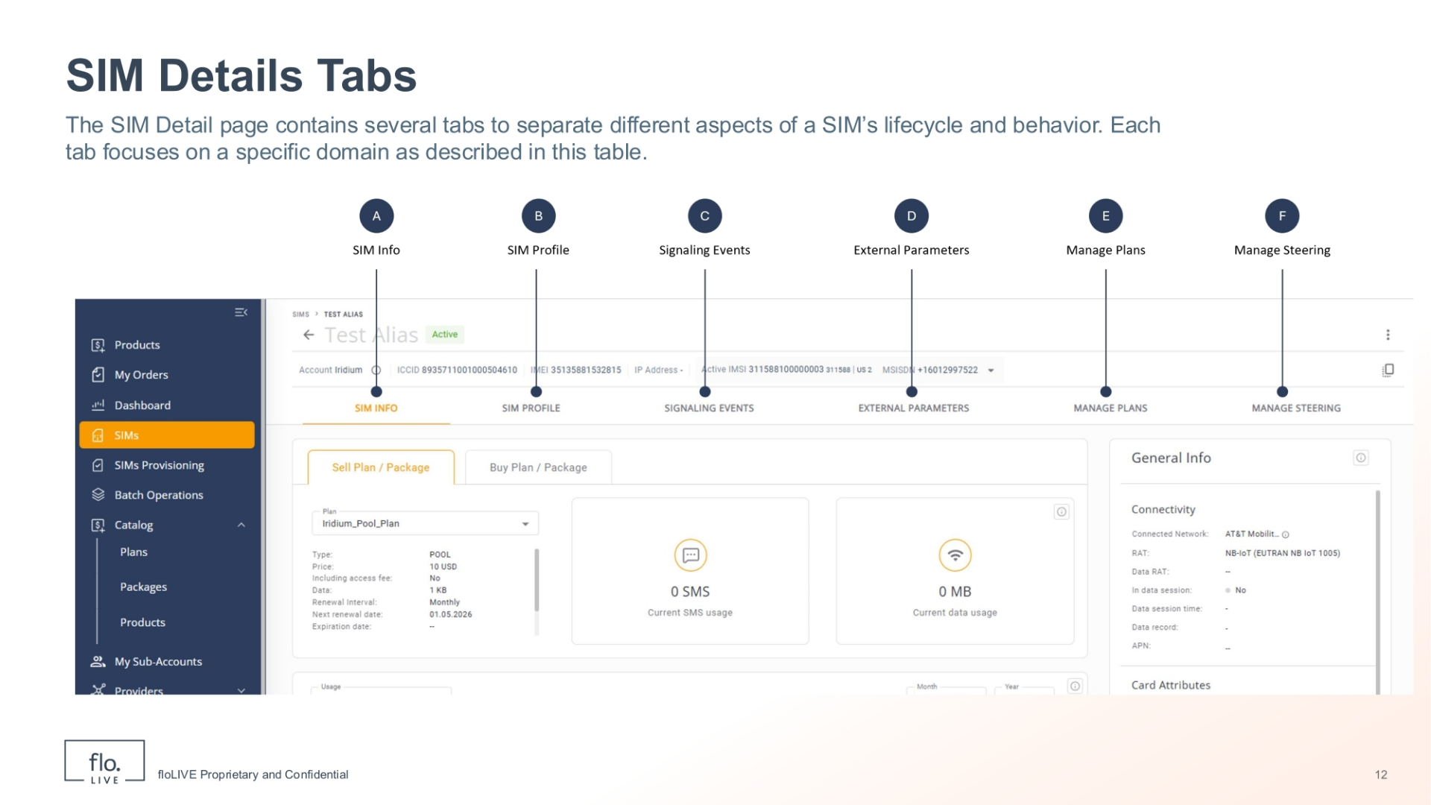
Notes:
Now lets explore the SIMs details page. This page is organized into several tabs, each representing a different aspect of the SIM lifecycle. This structure helps separate high‑level information, network identity, signaling history, configuration attributes, billing plans, and steering rules. By grouping related information into dedicated tabs, the platform makes it easier for users to navigate, troubleshoot, and manage SIMs.

Slide 13
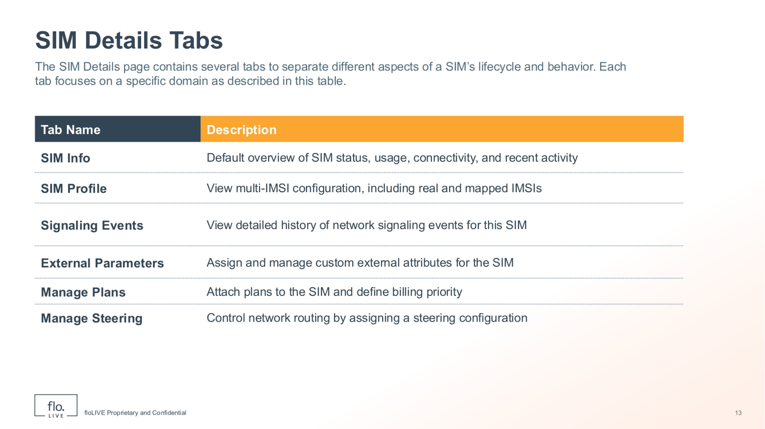
Notes:
This table explains the purpose of each SIM Details tab. SIM Info is the default tab and provides an overall view of the SIM’s status, usage, connectivity, and recent activity. The SIM Profile tab focuses on network identity and show multi‑IMSI configurations, including real and mapped IMSIs. The Signaling Events tab provides detailed visibility into core‑network signaling activity for troubleshooting connectivity issues. The External Parameters tab enables you to assign and manage custom attributes used for integration, automation, or classification. The Manage Plans tab is where billing plans are attached and prioritized for the SIM. Finally, the Manage Steering tab is where you control how the SIM is routed across networks by assigning a steering configuration. Lets dive into each of these tabs and explore the type of information you will find.

Slide 14
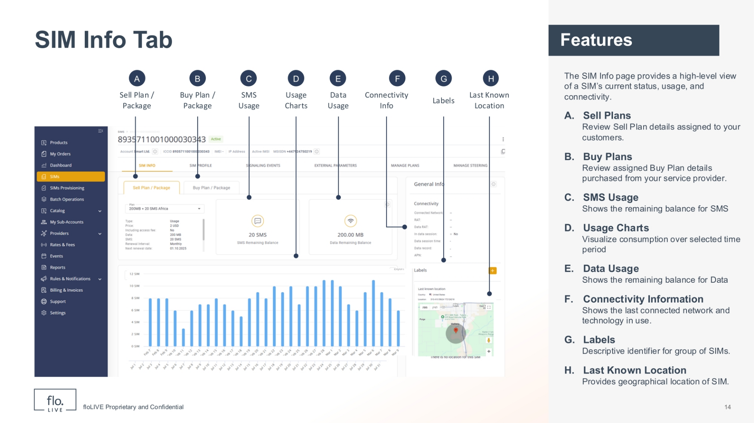
Notes:
The SIM Info tab provides a high‑level view of the current status, usage, and connectivity for a selected SIM. At the top, you can select the Sell and Buy Plan tabs to show details of how the SIM is provisioned commercially. You can also view the remaining SMS and data balances, along with usage charts to visualize consumption over time. On the right, the Connectivity Information panel shows the last connected network and technology, while Labels and Last Known Location provide operational context. Together, these sections give you a clear snapshot of how the SIM is configured, used, and connected.

Slide 15
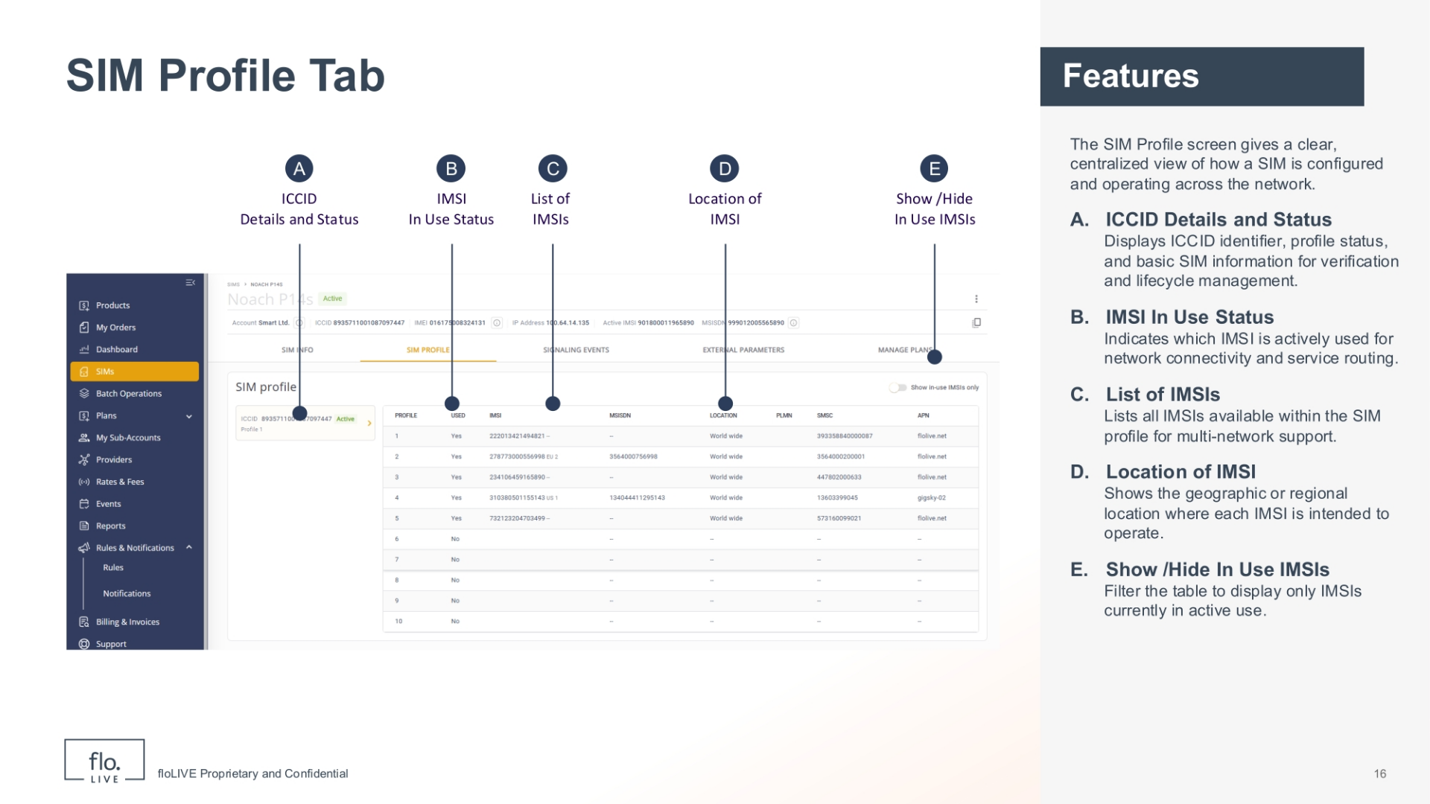
Notes:
The SIM Profile screen provides a clear, centralized view of how a SIM is configured and operating across the network. In the left panel you can see the SIM ICCID and its current status, confirming whether the SIM and its profiles are active. The table on the right lists all the associated IMSIs, and clearly indicates which IMSI is currently in use. For each IMSI, the screen shows key operational details such as the assigned MSISDN, geographic usage location, preferred mobile network, and SMS configuration. A simple toggle allows users to focus only on active IMSIs, making troubleshooting and monitoring faster. In summary, this screen helps operators quickly understand SIM behavior, validate connectivity settings, and manage multi‑IMSI or multi‑profile SIMs.

Slide 16
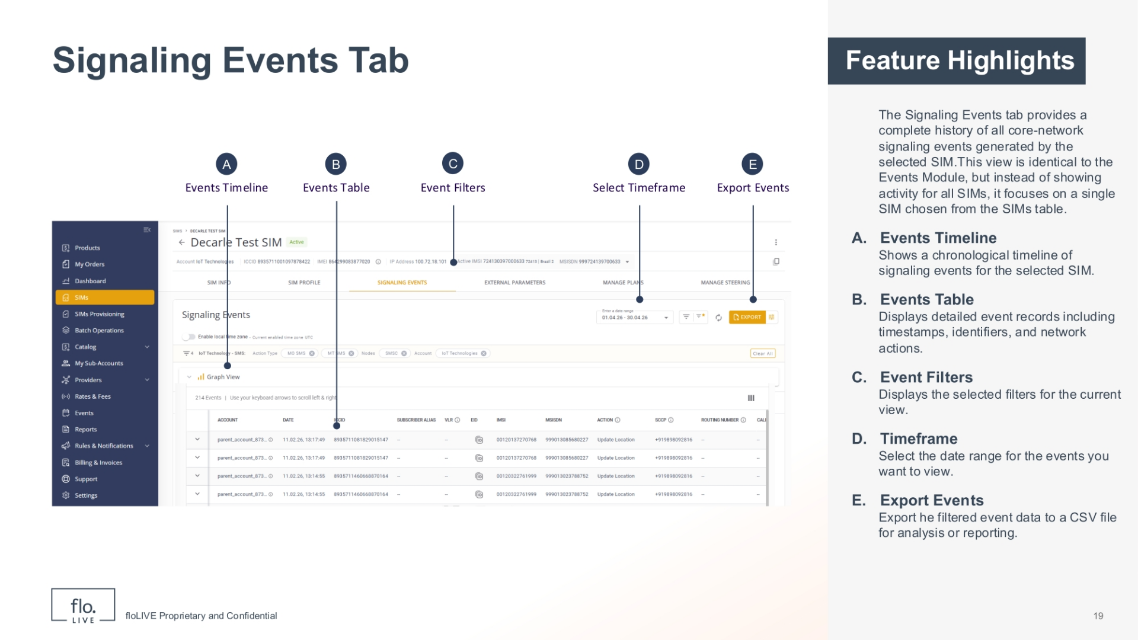
Notes:
The Signaling Events tab displays a complete history of all core‑network signaling events generated by the selected SIM. This view is identical to the Events Module, but instead of showing activity for all SIMs, it focuses on a single SIM chosen from the SIMs table. In the Signaling Events tab you can trace every registration attempt, location update, Date and SMS signaling action, and other network‑level events. This helps users to understand how the SIM interacts with the network, identify connectivity issues, and analyze behavior over time. The Signalling Events tab includes a chronological events timeline, a detailed events table, and filtering tools that help you isolate patterns, trends, and anomalies. You can also filter events, select a timeframe, review detailed event records, and export the data for troubleshooting, reporting, or audit purposes.

Slide 17
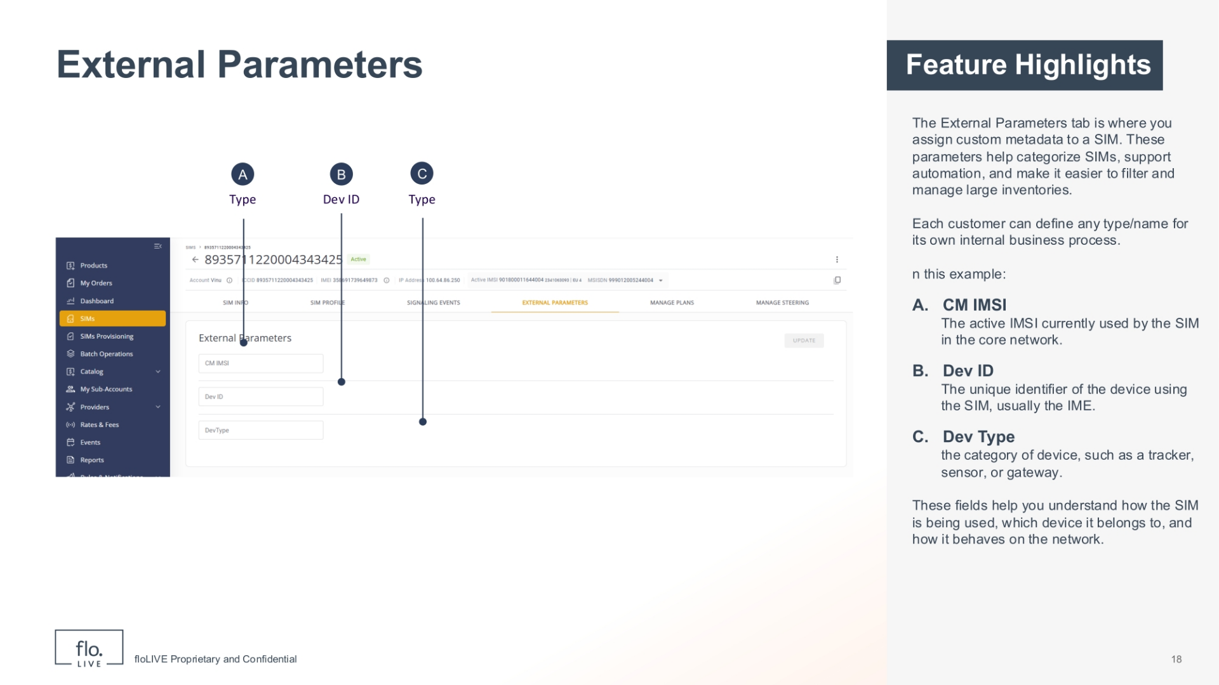
Notes:
The External Parameters tab is where you assign custom metadata to a SIM. These parameters help categorize SIMs, support automation, and make it easier to filter and manage large inventories. Each parameter has a name, a type, and a value. You simply choose the parameter you want to assign, enter the appropriate value, and save it to the SIM. When applied, these parameters become searchable across the entire SIM fleet. In this example, the fields you see for external parameters include: The CM IMSI,which is the active IMSI currently used by the SIM in the core network. The Dev-ID which is the unique identifier of the device using the SIM, usually the IMEI. and the Dev Type which refers to the category of device, such as a tracker, sensor, or gateway. This example shows how the SIM is being used, which device it belongs to, and how it behaves on the network.

Slide 18
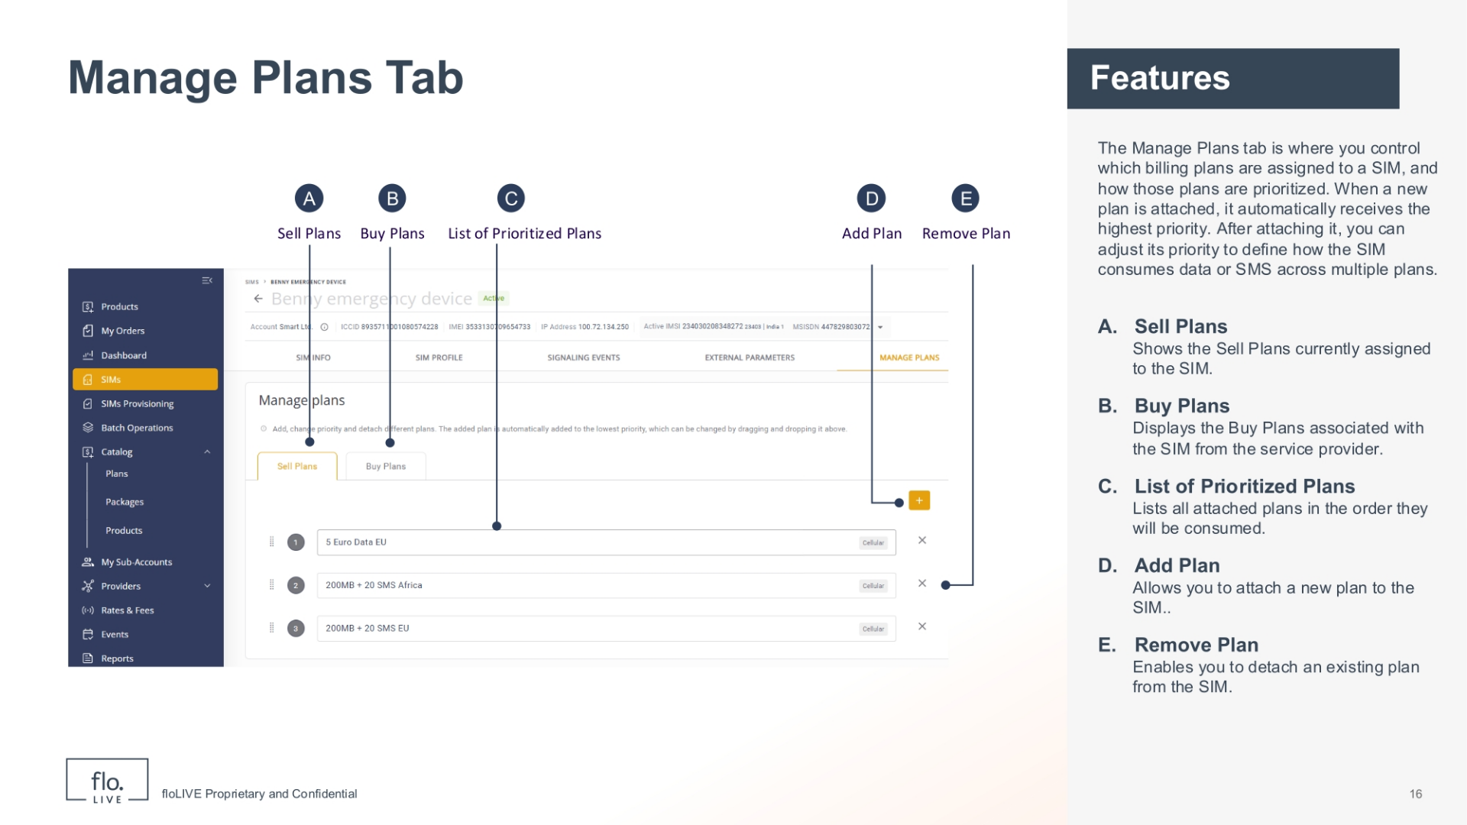
Notes:
The Manage Plans tab is where you control which billing plans are assigned to a SIM, and how those plans are prioritized. From this screen, you can attach multiple plans to a SIM—one at a time—and you can also detach plans individually. When a new plan is attached, it automatically receives the highes priority. After attaching it, you can drag and drop each plan to adjust its priority. The order of plans defines how the SIM consumes data or SMS across multiple plans. This priority order is what enables tiered pricing. Because each SIM can have its own unique set of plans, you can assign different billing rates to different SIMs, even when they belong to the same account. Keep in mind: each SIM can have up to four plans attached at once.

Slide 19
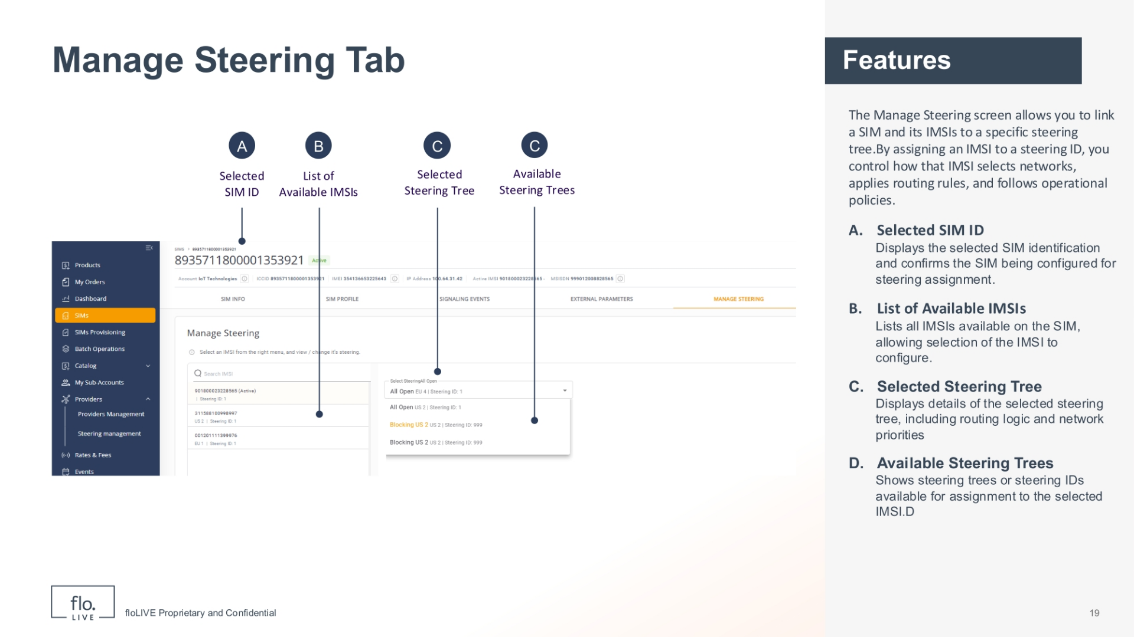
Notes:
The Manage Steering screen allows you to link a SIM and its IMSIs to a specific steering tree. By assigning an IMSI to a steering ID, you control how that IMSI selects networks, applies routing rules, and follows operational policies. This ensures the SIM uses the correct connectivity behavior for its deployment, location, and service requirements. The Selected SIM ID displays the selected SIM identification and confirms the SIM being configured for steering assignment. The List of Available IMSIs shows all IMSIs on the SIM that are available for configuration. The Selected Steering Tree field enables you to change the IMSI steering settings for available steering trees. The Available Steering Tree drop-down list shows steering trees or steering IDs available for assignment to the selected IMSI.

Slide 20
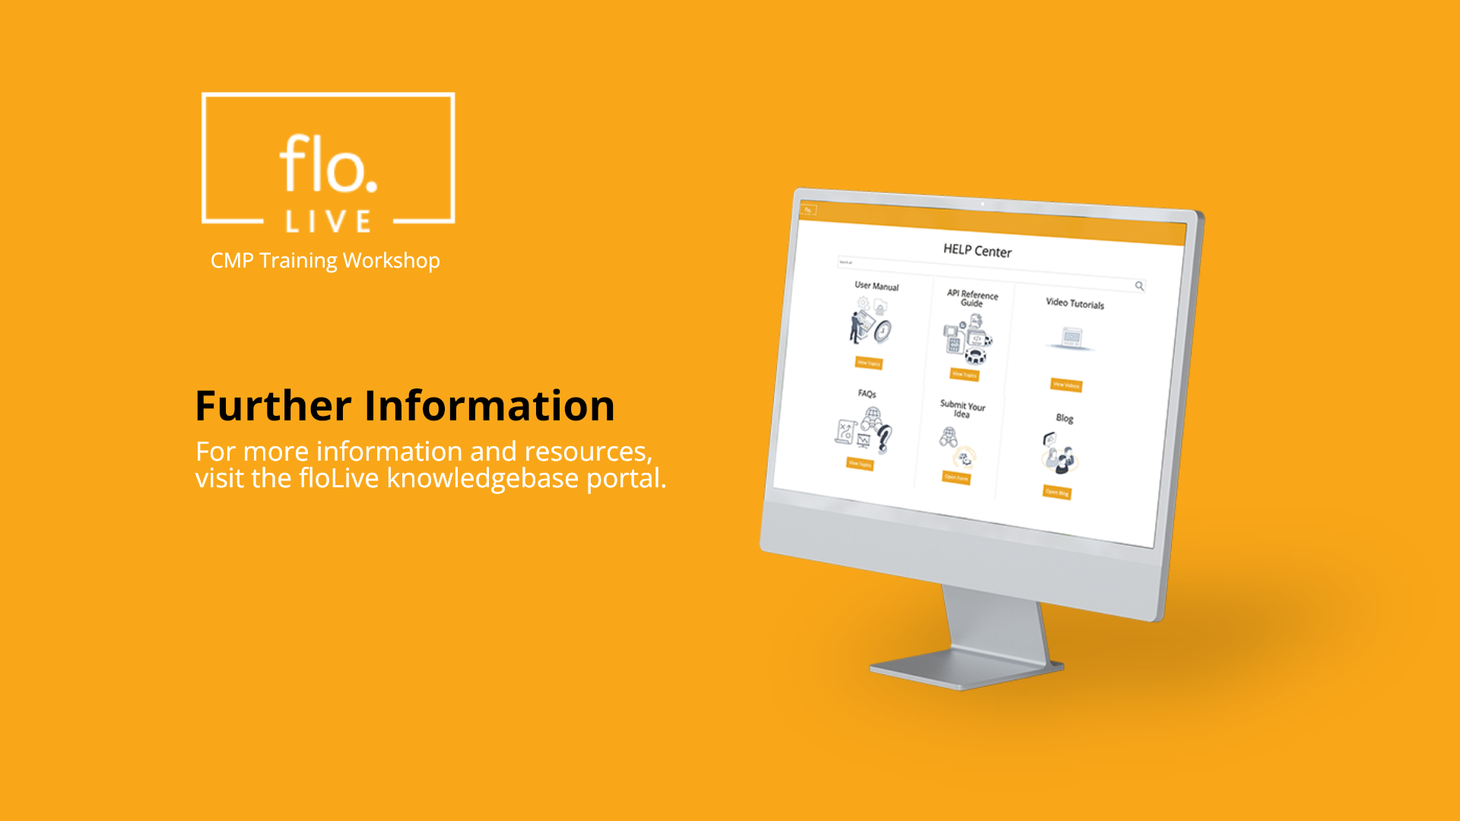
Notes:
Thank you for watching this video tutorial. For more information about the CMP system, make sure you visit our Knowledge-base that is accessible directly from the CMP Portal.

